Slide 1
Review of Cardioversion Procedure
Brandon Neuenschwander

Slide 2
Overview
As a result of increased MRC cases involving ventricular tachycardia with a pulse and other tachycardia dysrhythmias requiring cardioversion, it was considered beneficial to review the following information.
Review of Ventricular Tachycardia
Tachycardia algorithm in the 2023 MD Protocol
Cardioversion procedure in the 2023 MD protocol
Lifepak 15 user manual recommendations for cardioversion procedure
Troubleshooting inappropriate sync site prior to cardioversion
Examples of appropriate and inappropriate sync sites for cardioversion
Take Home Points
Sources (for protocols and ECG examples, no in county ECGs were used for the presentation)

Slide 3
Ventricular Tachycardia (with a pulse)
Definition
A ventricular based tachycardia (greater than/equal to three consecutive beats) that are typically at rates greater than 120 and less than 250 beats per minute containing QRS widths greater than/equal to 0.12 seconds. Maryland Medical Protocol identifies treatable tachycardia as rates >150 beats per minute. If there is difficulty identifying your patients rhythm as ventricular tachycardia vs SVT with a wide QRS complexes, you can utilize the tips listed in the next few slides and/or transmit your ECG to an approved ER facility for physician review.
True ventricular tachycardia will cause a drastic decrease in cardiac output, if not treated it will likely progress to ventricular fibrillation/cardiac arrest.

Slide 4
Ventricular Tachycardia
Causes
Most Common
Less Common
Arrhythmogenic Right Ventricular Cardiomyopathy
Brugada Syndrome
Long QT syndrome
Sarcoidosis
Coronary Vasospasm
Electrolyte Disorders
Congenital Heart Disease
Catecholamine Induced Ventricular Tachycardia
Coronary Heart Disease
Heart Failure
Cardiomyopathy
Valvular Disease

Slide 5
Ventricular Tachycardia
Identification
There are many different criteria that can be used to make the determination between Ventricular Tachycardia vs STV with a wide QRS complex, the next few slides are a few characteristics to help make the identification but may not be required. The basic definition previously listed must also be met.
It is safe to assume that the majority of the time if the patient meets the definition listed earlier for Ventricular Tachycardia and falls within the treatment plan under the Maryland Protocol (especially if symptomatic), it is considered Ventricular Tachycardia until proven otherwise.
IMPORTANT TO REMEMBER

Slide 6
Ventricular Tachycardia
Identification - Electrical Axis
Electrical axis is between -90 and -180 degrees should cause a high suspicion of VT
Changes in electrical axis of >40 degrees when alternating between the underlying sinus rhythm and runs of Ventricular Tachycardia
VT impulse direction
Normal impulse direction

Slide 7
Ventricular Tachycardia
Identification - Mimic RBBB
When viewing V1 utilize the tip below to make the determination between VT vs accelerated rhythm with RBBB. *remember the basic criteria must be met as well*

Slide 8
Ventricular Tachycardia
Identification - LBBB
When viewing V1 this is the general appearance of VT LBBB.

Slide 9
Ventricular Tachycardia
Identification - Capture and Fusion Beats
Both capture and fusion beats are diagnostic of VT, these are impulses that managed to override the ventricular impulses. They stand as verification that the primary source of the previous rhythm was ventricular in nature.

Slide 10
Ventricular Tachycardia
Identification - Atrioventricular Dissociation
Atria and ventricles will function independently. This is difficult to identify at elevated heart rates but if seen is a trait of VT.

Slide 11
Ventricular Tachycardia
CAUTION
The basic criteria must be met, according to Maryland Protocol this requires a heart rate greater than/equal to 150bpm consistently, QRS complex greater than/equal to 0.12 seconds. In cases where the rate is <150bpm OR the QRS is >0.2 seconds(extremely wide), there should be consideration for alternative causes to wide complex rhythm, especially toxicology and metabolic if no cardiac history is present. Always try to acquire a accurate SAMPLE to rule out alternative causes.
Patient with hyperkalemia, if given amidarone could result in asystole
Patient with TCA overdose, if given amidarone could result in asystole
Rate <150bpm and extremely wide QRS, consider alternative causes
Rate <150bpm and extremely wide QRS, consider alternative causes

Slide 12
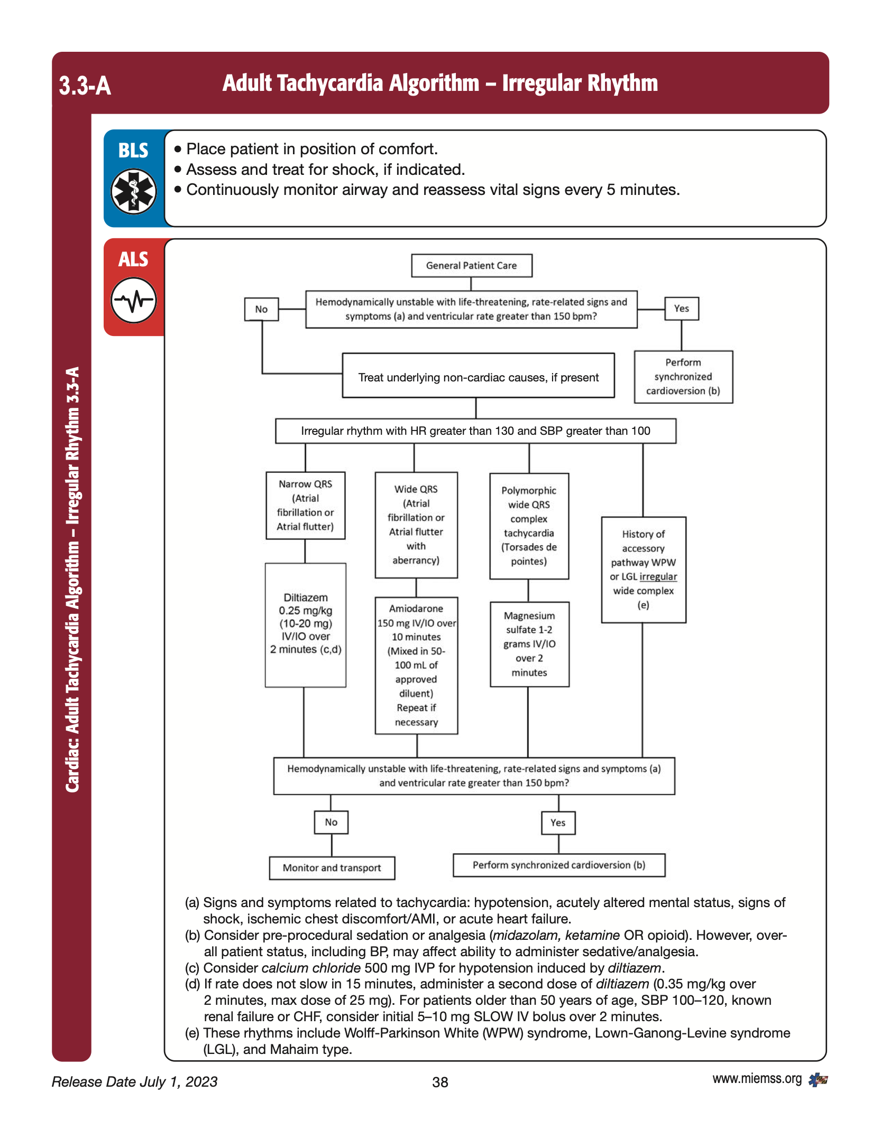
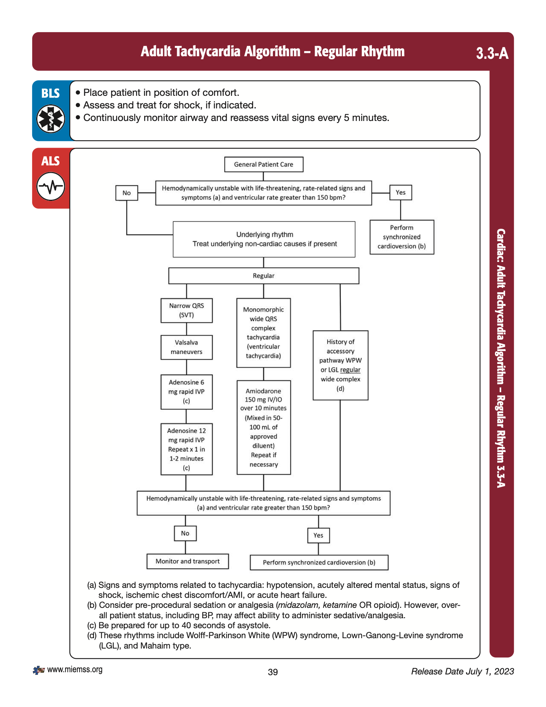
Tachycardia Algorithm
Frequently forgotten, can have
life threatening results if treated
with Cardizem, Verapamil or Amiadarone

Slide 13
Wolff Parkinson White Syndrome
Review of characteristics when associated with Afib RVR
Delta Wave (can be difficult to find in severe tachycardia)
Rates reaching up to 300 beats per min
Varying QRS width
MAKE SURE TO VERIFY HISTORY BEFORE CARDIZEM/VERAPAMIL
Changing QRS widths
Delta Wave
Rates up to 300bpm

Slide 14
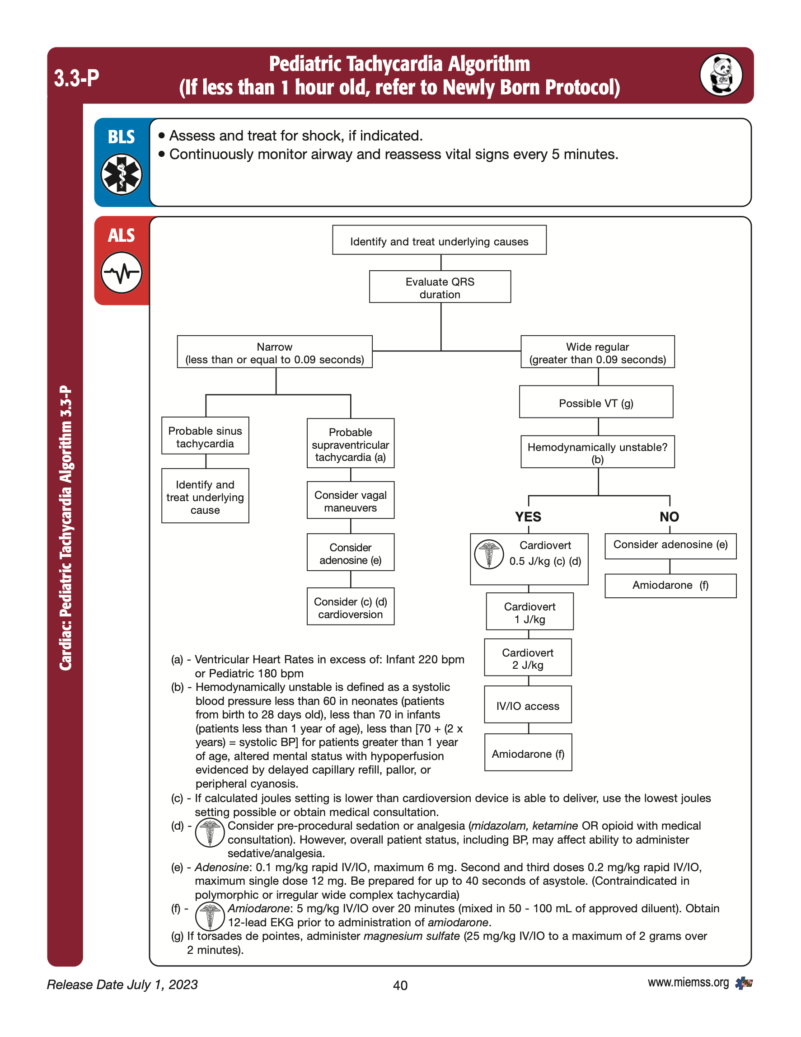
Tachycardia Algorithm
Prior to treating elevated heart rate the clinician should attempt to identify and treat alternative causes for tachycardia.
Alternative causes include other forms of shock where tachycardia is considered compensatory. Examples such as sepsis, trauma and toxicology where electrical intervention would unlikely be the primary treatment.
Ketamine added as a medication that can be used for pain management related to electrical therapy.

Slide 15
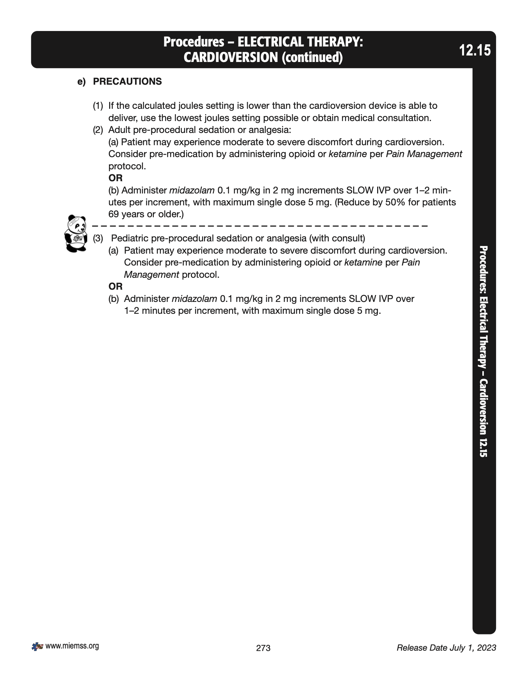
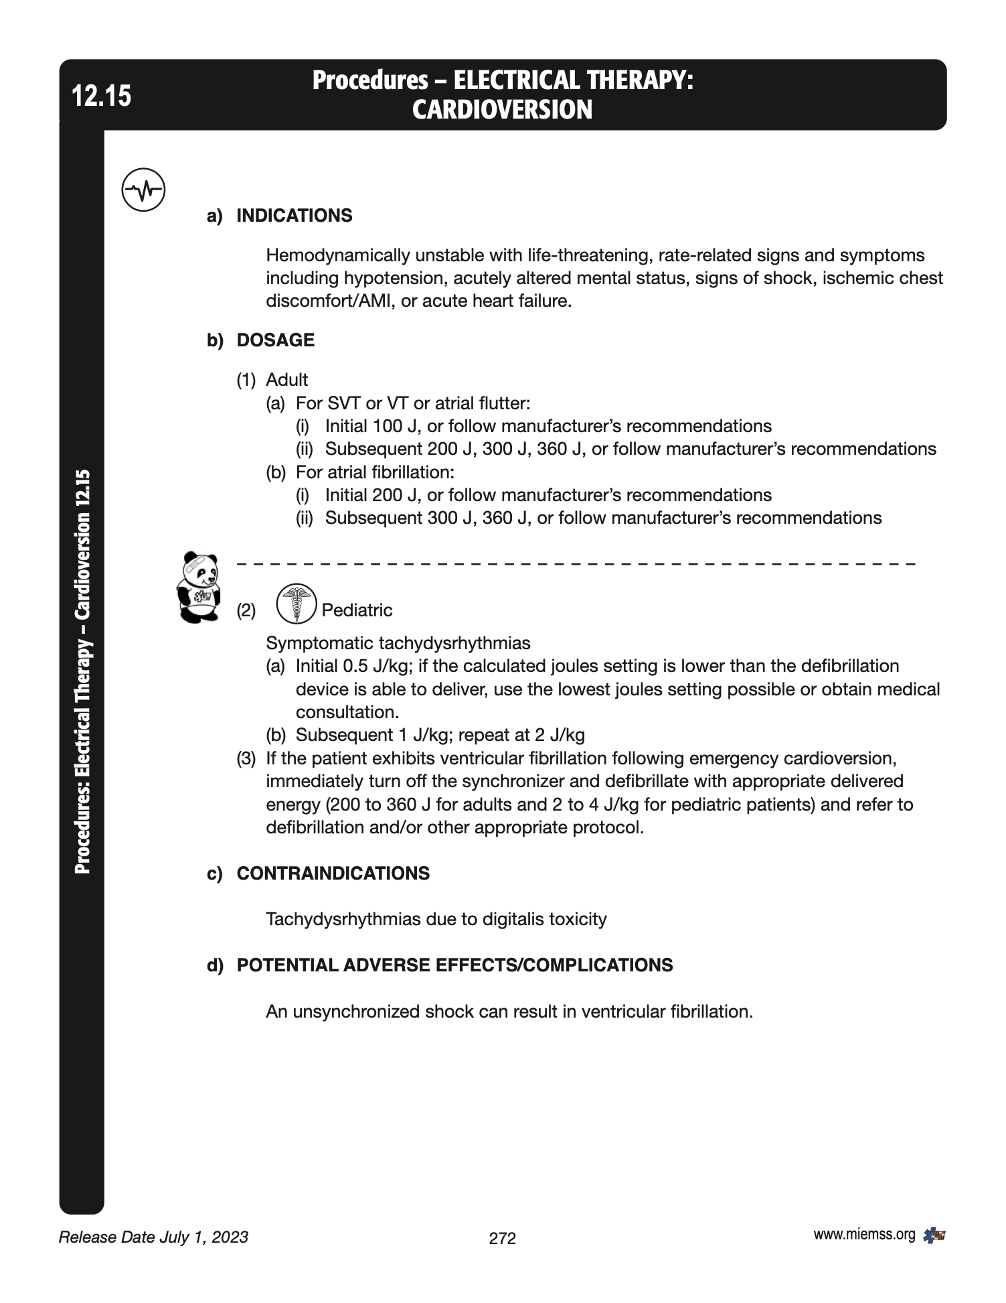
MD Protocol - Cardioversion
verify your dosage in J based on the rhythm you are treating

Slide 16
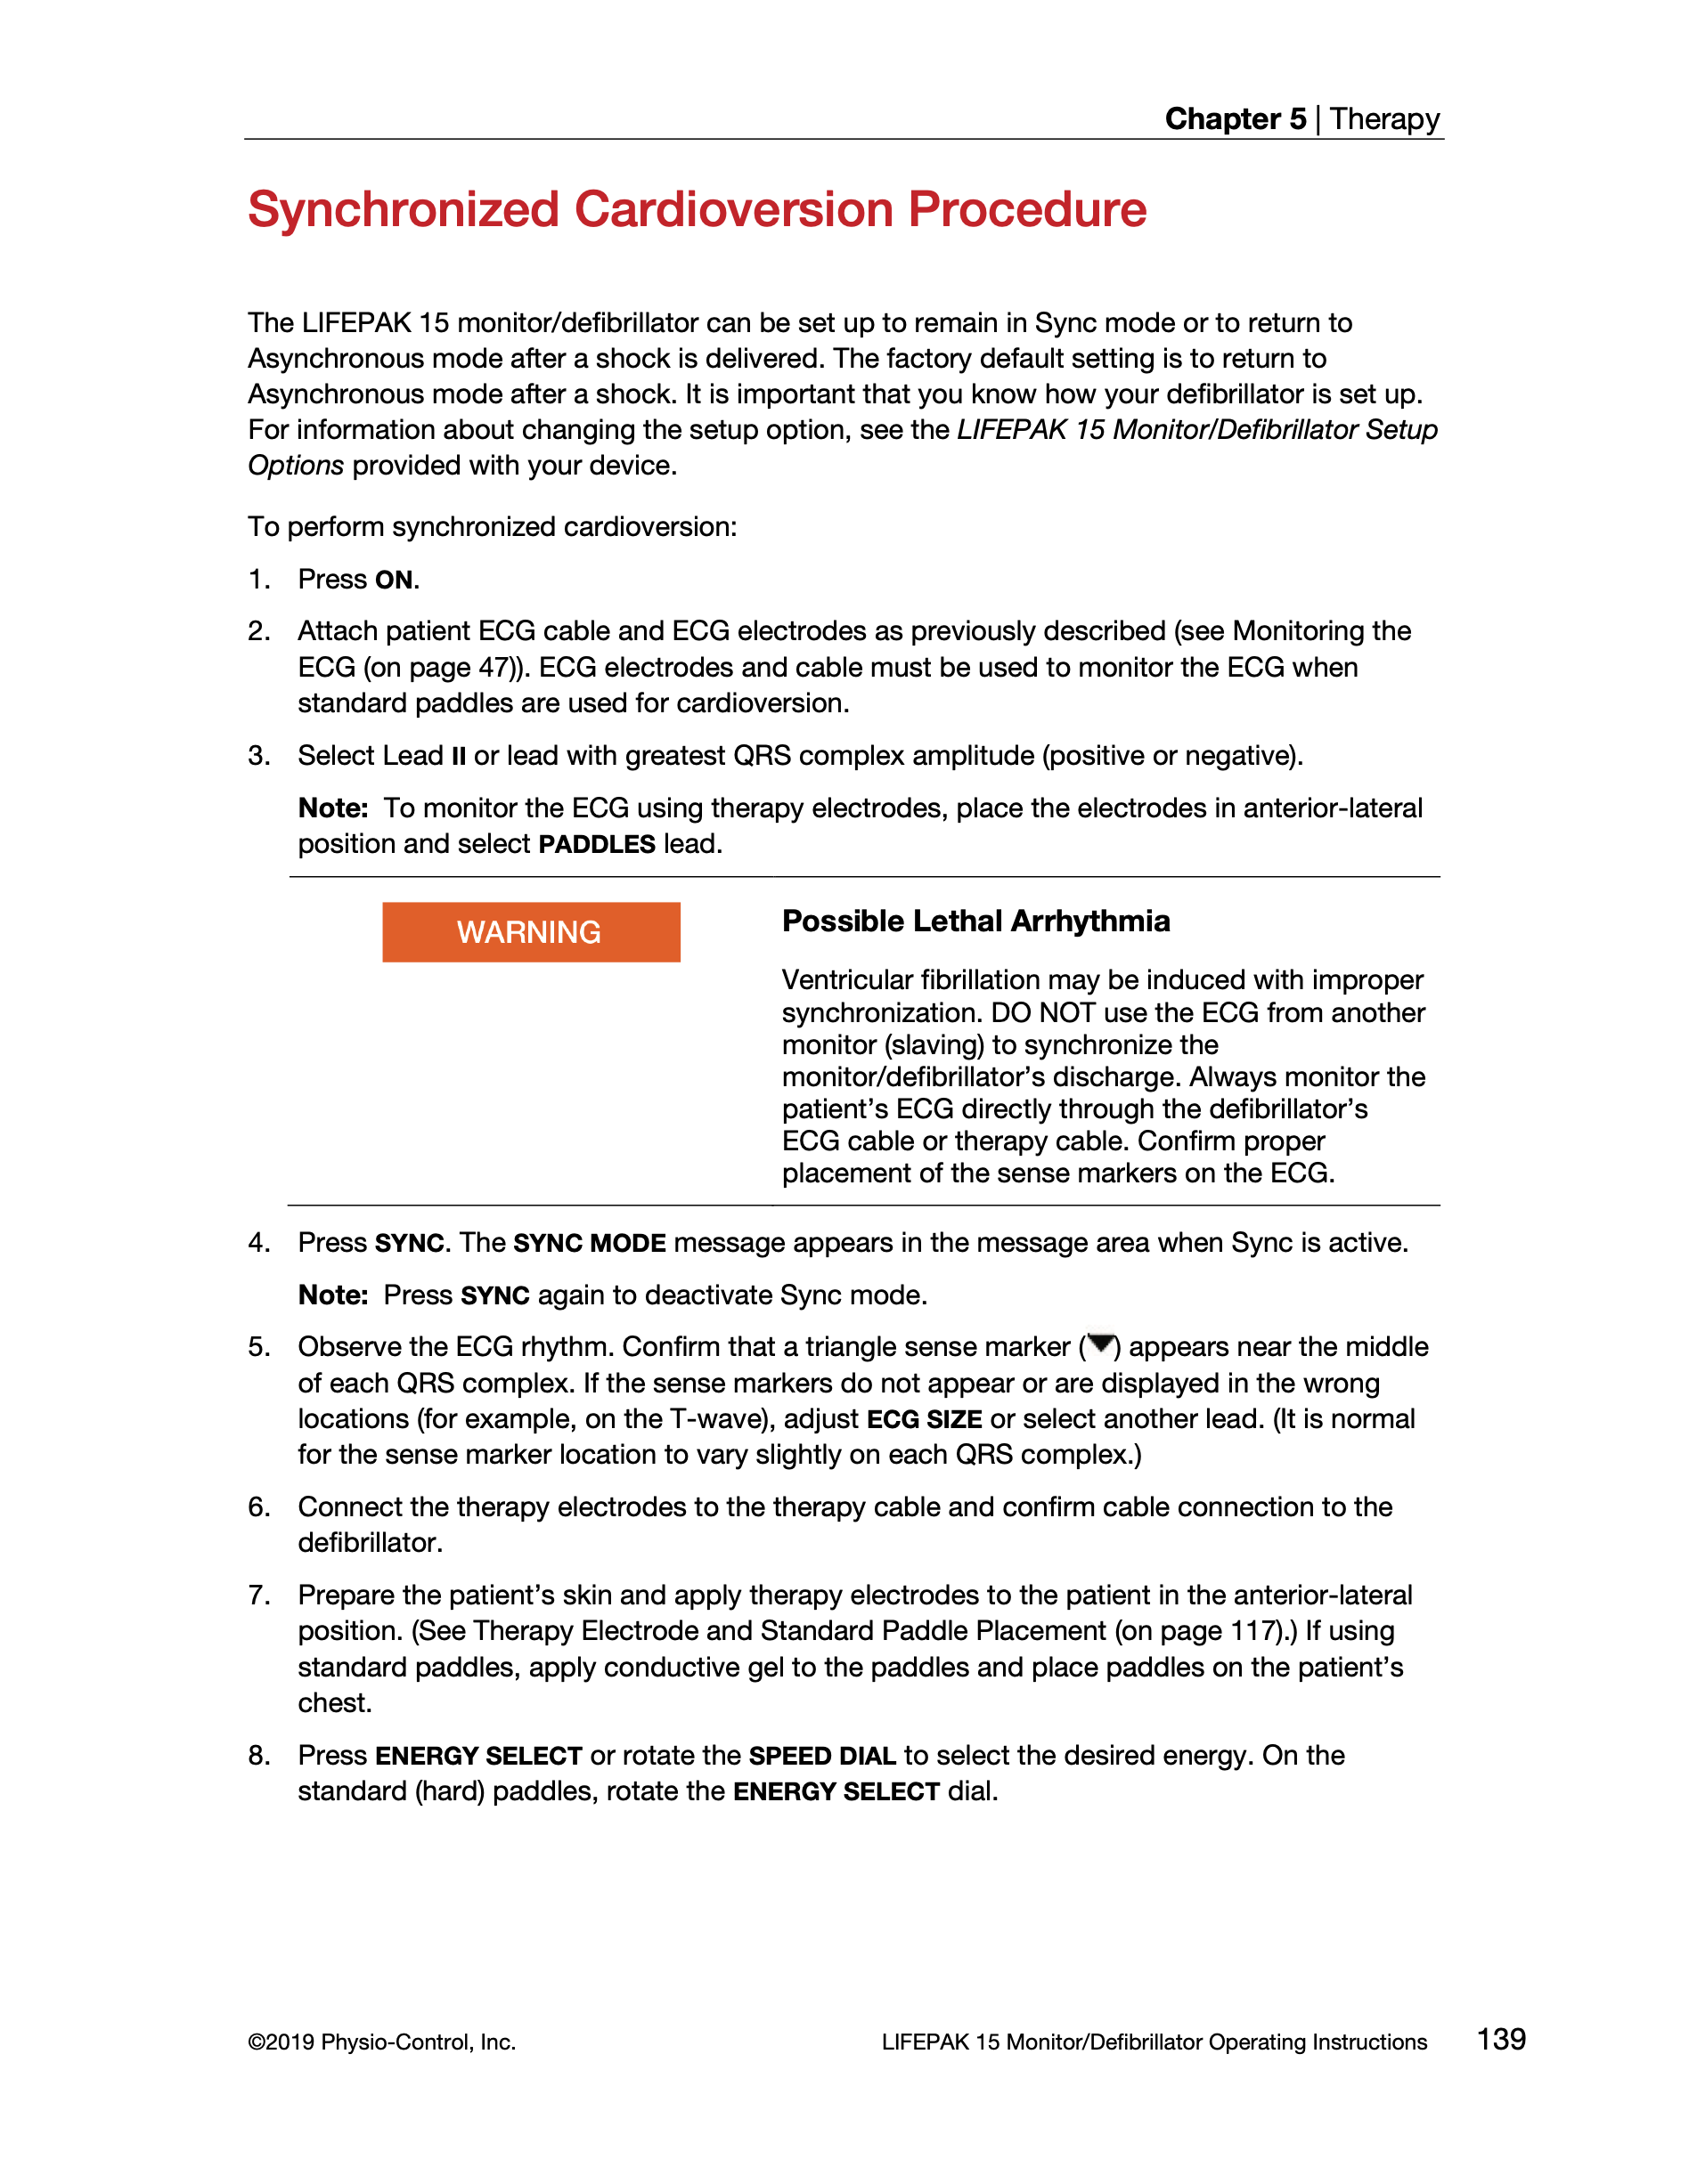
Lifepack 15 Operating Instructions
You can use Lead II OR the lead with the greatest QRS complex amplitude. This will aid the monitor in locating the correct location to sync. Cardioversion while on the T wave could result in lethal arrhythmia.
Troubleshoot inappropriately selected sync sites:
Adjust ECG size
Select another lead

Slide 17
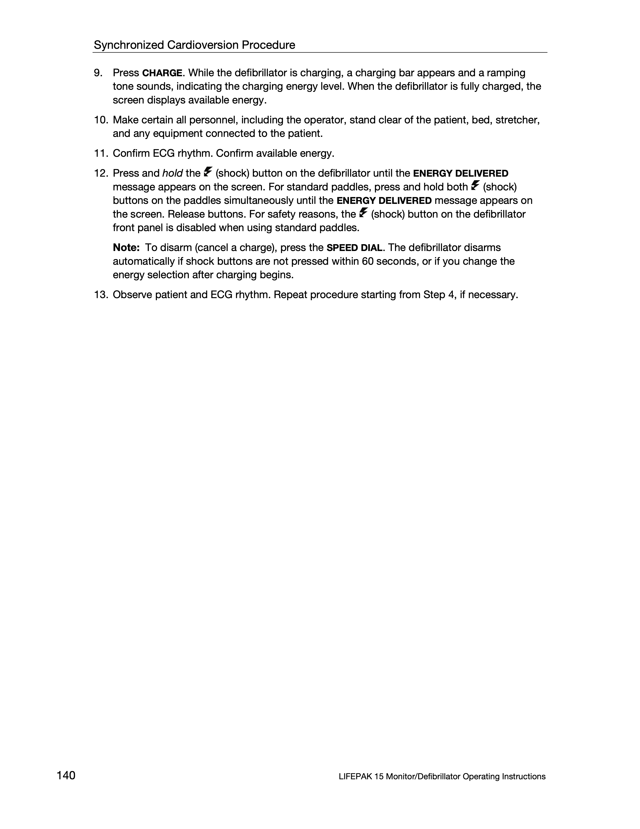
Lifepak 15 Operating Instructions
Be sure all crew members and family stay clear of the patient prior to cardioversion.
Make sure to press AND hold the shock button
If you need to disarm a charged monitor press the speed dial. The Lifepak will automatically disarm a charge if not delivered in 60 seconds or energy select is adjusted after charge begins.

Slide 18
Appropriate and Inappropriate sync sites for cardioversion
Possible T Wave Location
Possible T Wave Location
Appropriate sites labeled in GREEN
Inappropriate sites labeled in RED

Slide 19
Appropriate and Inappropriate sync sites for cardioversion
If in doubt, remember you can use alternative leads to aid in identifying the QRS and T wave locations
T Wave Location
QRS Location

Slide 20
Appropriate and Inappropriate sync sites for cardioversion
Notice on this case where the sync shifted from the QRS to the T Wave
Possibly from movement artifact or last minute change in morphology causing the sync to
mark the tall T wave. This resulted in a conversion to what appears to be a new shockable rhythm.
Likely T Wave Location
Successful cardioversion

Slide 21
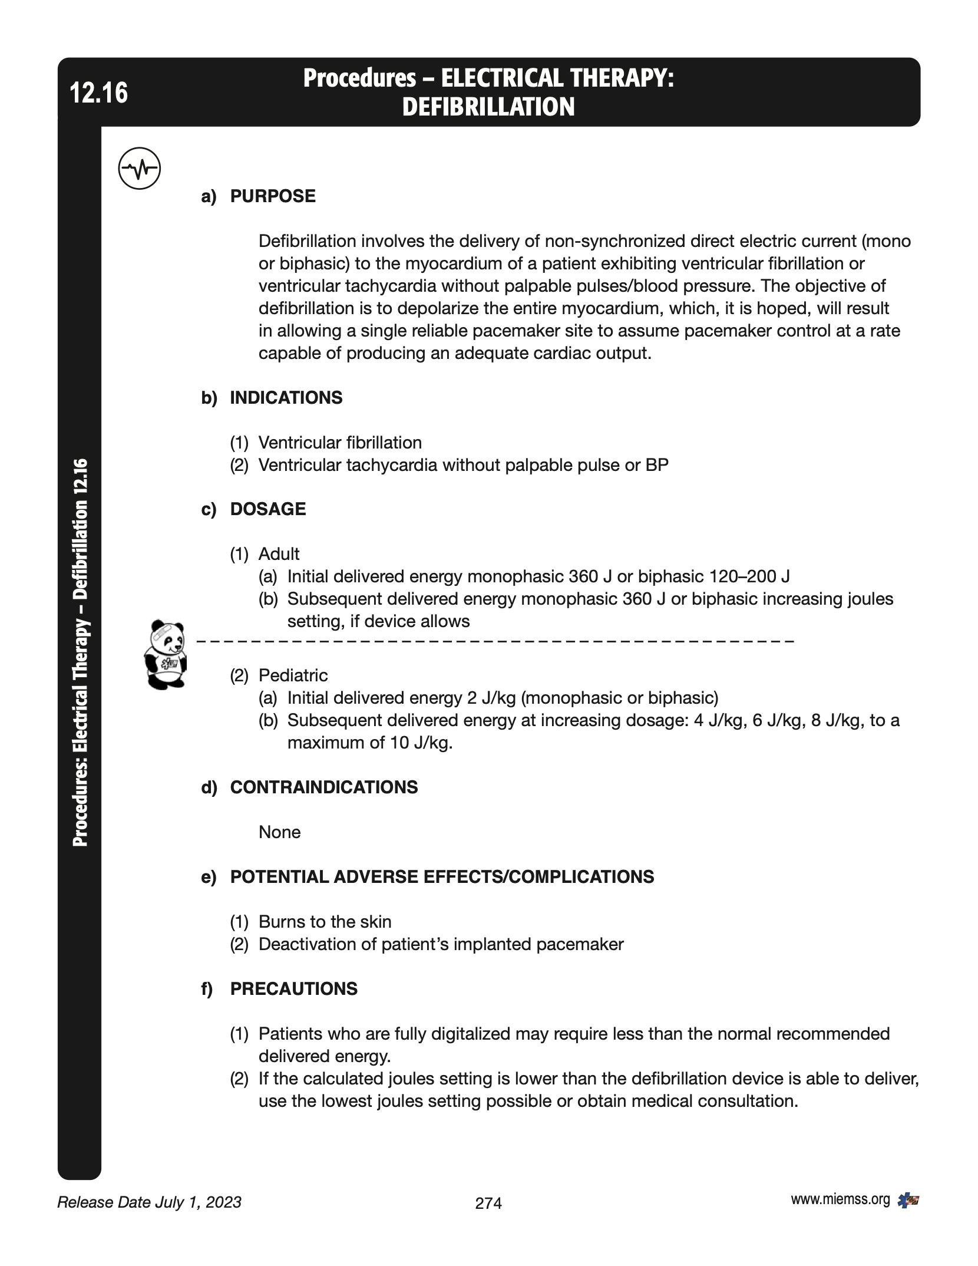
Inappropriate site cardioverted?
If patient converts to a Vfib/pulseless Vtach immediately initiate treatment identified in Maryland Medical Protocol for new rhythm.

Slide 22
Take Home Points
After speaking with Physio representatives, we were informed that it is EXTREMELY unlikely the Lifepak will sync on a T wave. The monitor uses “slopes and angles” to identify safe cardioversion sites.
In cases of TRUE ventricular tachycardia with a pulse, when the monitor is synced it is EXTREMELY unlikely to mark the T wave. Verification of TRUE ventricular tachycardia being the key vs other rhythms that can mimic this dysrhythmia.
In cases where other wide complex tachycardia rhythms present, for example atrial fibrillation with underlying BBB, SVT with aberrancy, peaked T waves. It is still UNLIKELY the T wave will be marked but use your knowledge and tools to verify the correct location is synced.
If the incorrect location is synced or you are unsure, you have the ability to follow the trouble shooting techniques listed by the Lifepak manual. You also have the ability to transmit your ECG to an emergency department and request a physician consult. As always, a risk/reward analysis should be used regarding delay in patient care if cardioversion is indicated.
In all cases of cardioversion, always be mindful of crew safety prior to delivering electrical intervention. Also, be prepared to treat the rhythm that results after the shock is delivered.

Slide 23
Sources
http://hqmeded-ecg.blogspot.com/2013/10/polymorphic-ventricular-tachycardia.html
https://litfl.com/supraventricular-tachycardia-svt-ecg-library/
https://www.amboss.com/us/knowledge/Atrial_fibrillation_with_rapid_ventricular_response
https://www.sciencedirect.com/science/article/pii/S1878540920301146
https://johnsonfrancis.org/professional/cardioversion-of-ventricular-tachycardia-on-ecg-rhythm-strip/
https://www.miemss.org/home/Portals/0/Docs/Guidelines_Protocols/MD-Medical-Protocols-Web-06-01-2023.pdf
https://www.stryker.com/content/dam/stryker/ems/resources/operating-instructions/international/3314911-030_int-eng_lifepak_15_operating_instructions.pdf
https://thephysiologist.org/study-materials/determining-cardiac-axis/
https://www.aclsmedicaltraining.com/blog/wide-complex-tachycardia-treated-with-amiodarone-and-synchronized-cardioversion/
https://ecgwaves.com/topic/ventricular-tachycardia-vt-ecg-treatment-causes-management/
https://www.escardio.org/Journals/E-Journal-of-Cardiology-Practice/Volume-14/fourteen-twelve
https://coreem.net/core/tricyclic-antidepressant-toxicity/
http://blog.clinicalmonster.com/2018/02/22/bored-review-atrial-fibrillation-wpw-syndrome/
https://emj.bmj.com/content/20/5/491
ecgweekly.com - numerous cases
https://litfl.com/vt-versus-svt-ecg-library/
https://slideplayer.com/slide/1663171/

